Slide 1

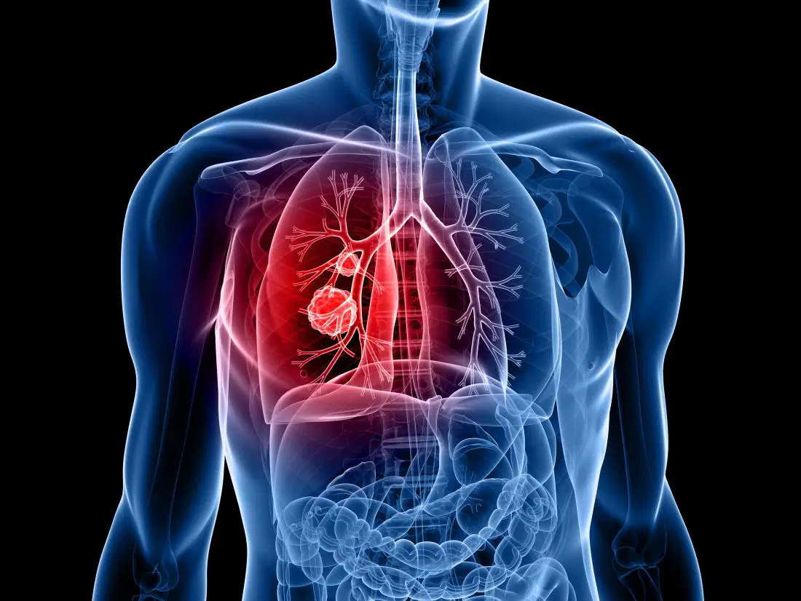

IT-326
Lung Cancer
Data Mining
Presented By:
Alanoud Alhudhaif
Aleen Aldosari
Maraheb Alrashedi
Shatha AlSheddey

Slide 2


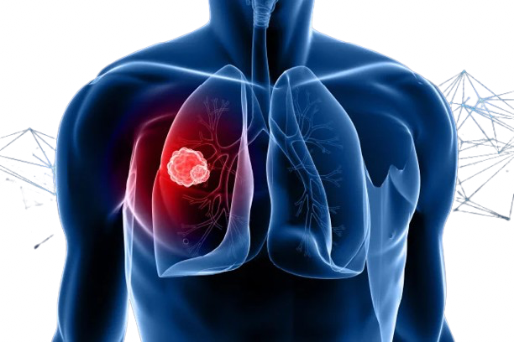

PROBLEM STATEMENT & OBJECTIVES
Dataset of lung cancer patients from Kaggle.
Includes demographic, lifestyle, exposure, and medical risk factors.
Objectives
Understand the relationship between risk factors and lung cancer.
Build classification models to predict lung cancer.
Cluster patients into meaningful risk groups.

Slide 3
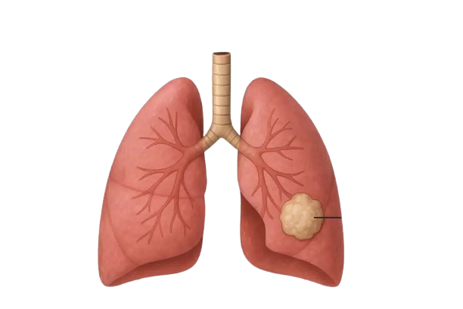
DATASET DESCRIPTION
50,000 records, 11 attributes
Target: lung_cancer (Yes / No)
EXAMPLE FEATURES:
age, gender
pack_years (smoking history)
radon_exposure,
asbestos_exposure
secondhand_smoke_exposure
copd_diagnosis,
alcohol_consumption,
family_history

Slide 4
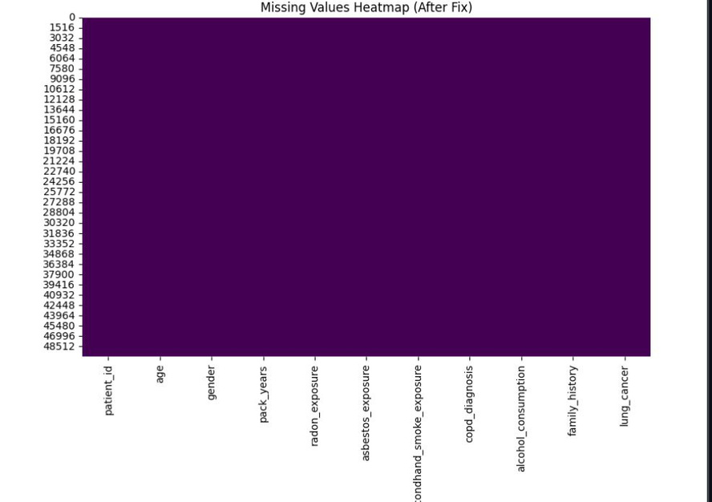
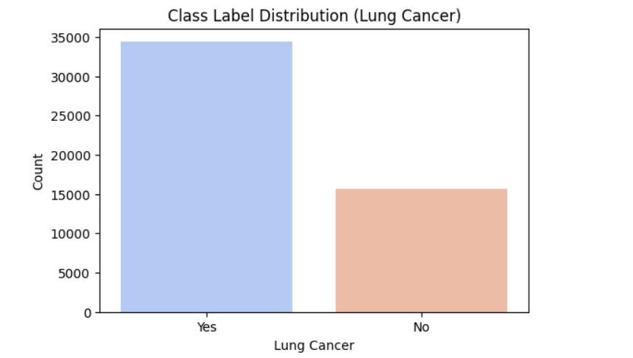
EXPLORATORY DATA ANALYSIS (EDA)
No missing values detected across all features.
Dataset is imbalanced: more “Yes” cases than “No”.

Slide 5
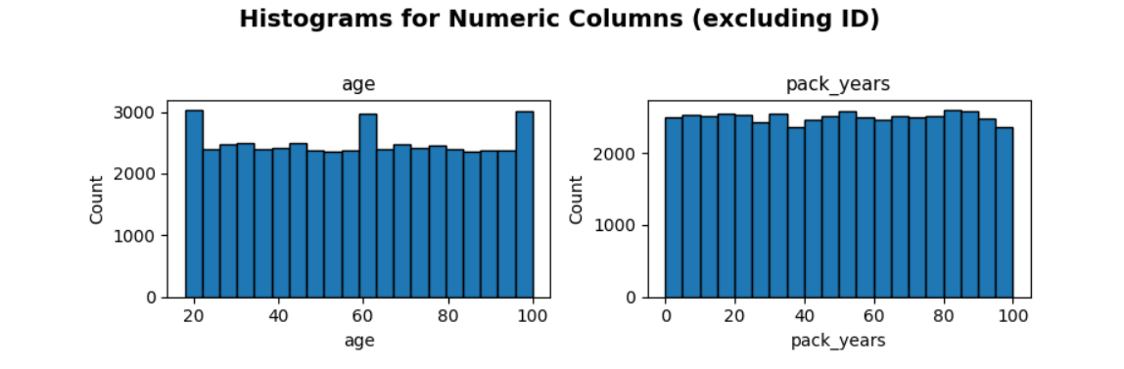
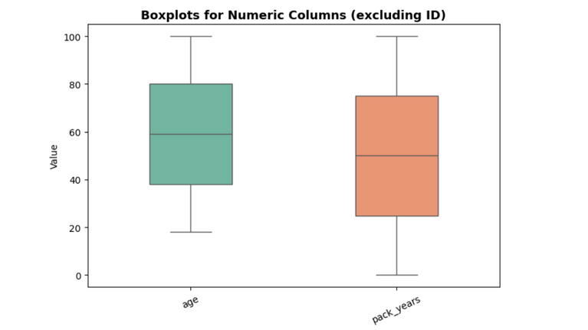
EXPLORATORY DATA ANALYSIS (EDA)
Age and pack_years show wide, evenly distributed ranges.
Both age and pack_years show normal spread with no significant outliers.”

Slide 6
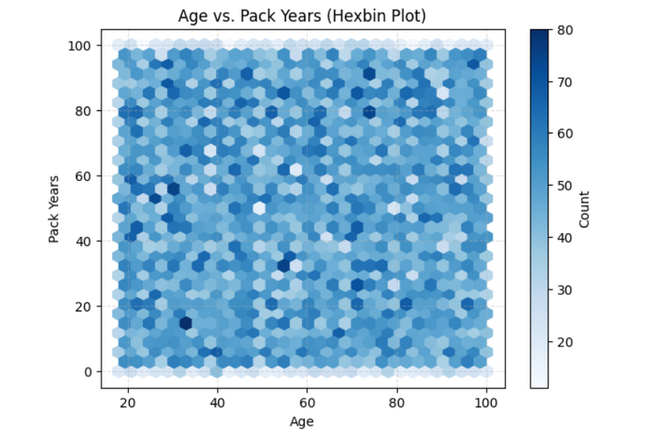
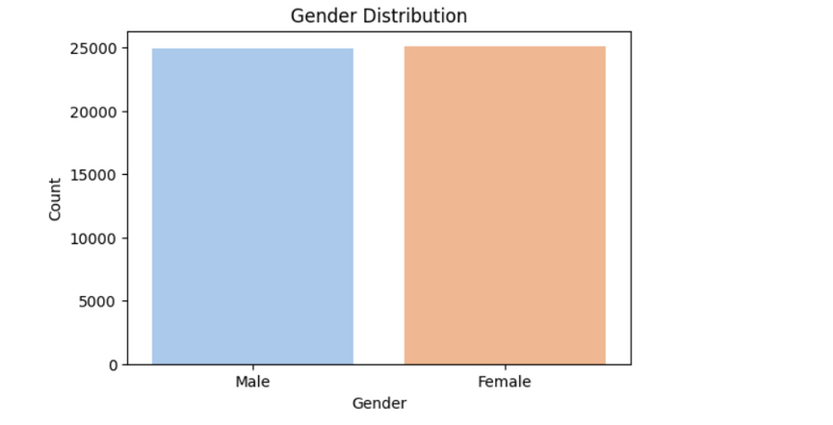
EXPLORATORY DATA ANALYSIS (EDA)
Balanced gender distribution (50%–50%).
Age and pack_years appear uniformly distributed, with no clear linear relationship. The density pattern indicates no strong correlation between the two variables.

Slide 7
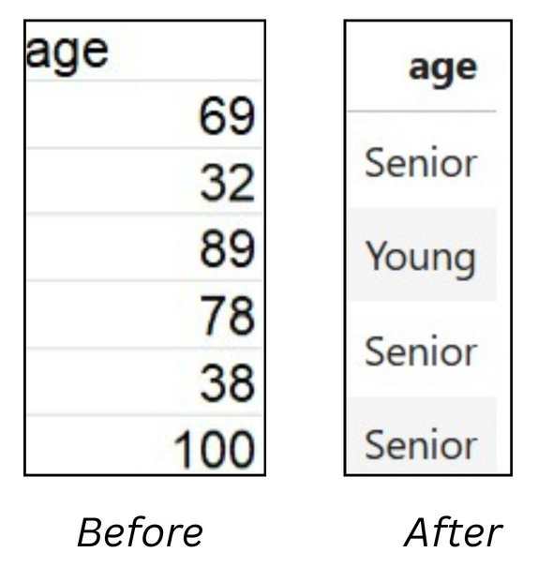
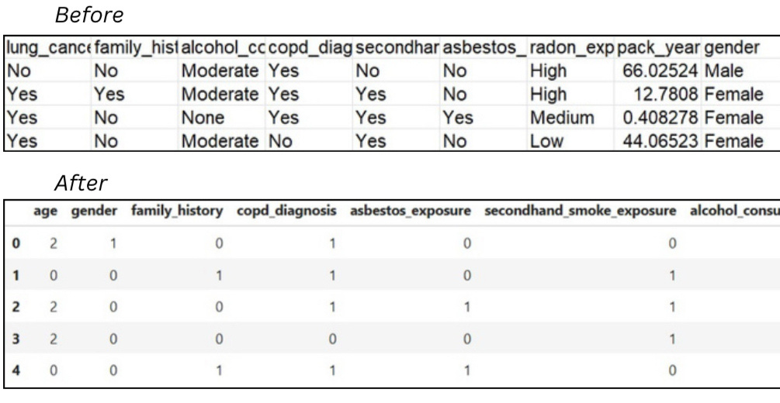
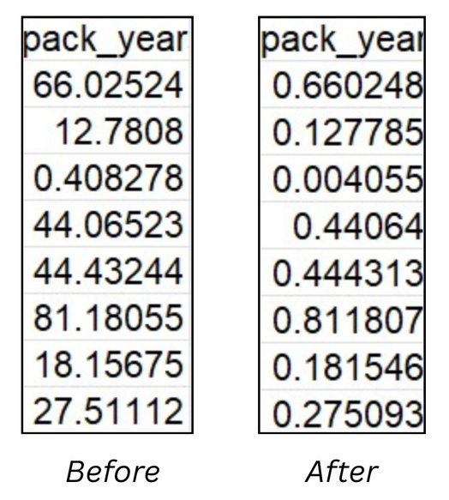
PRE-PROCESSING
Several preprocessing techniques were applied to clean and prepare
We applied three preprocessing techniques:
Expert in financial management and strategy.
DISCRETIZATION
ENCODING
NORMALIZATION

Slide 8
CLASSIFICATION
• Classification is supervised learning which mean is need a
class lapel to classify the objects.
• We trained our model to be able to predict if the patient has
lung cancer or not using (lung_cancer) class labe
• build our model We used a decision tree algorithm which is a recursive algorithm produces a tree with a leaf nodes representing the final decisions.

Slide 9

CLASSIFICATION TECHNIQUES
1-Data splitting
2-Decision Tree Training
3-Accuracy Evaluation
70/30, 80/20, and 90/10
Gini Index and Entropy.
comparing predicted labels with actual labels
4-Confusion Matrix
5-Decision Tree Visualization
visualize correct vs. incorrect predictions
We visualized the structure of the Decision Tree

Slide 10
DATA SPLITS
Training dataset: for building the decision tree.
Testing dataset: to evaluate the model.
01
02
03
90% Training
10% Testing
80% Training
20% Testing
70% Training
30% Testing
BORCELLE
WARDIERE INC.
SALFORD & CO.
0.6346
0.6487
0.6378
0.6488
0.7294
0.6517

Slide 11
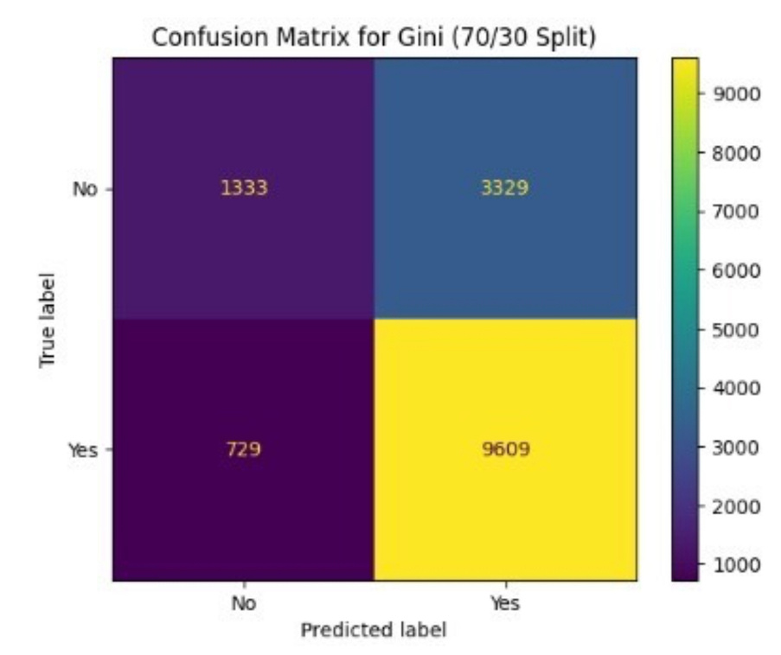
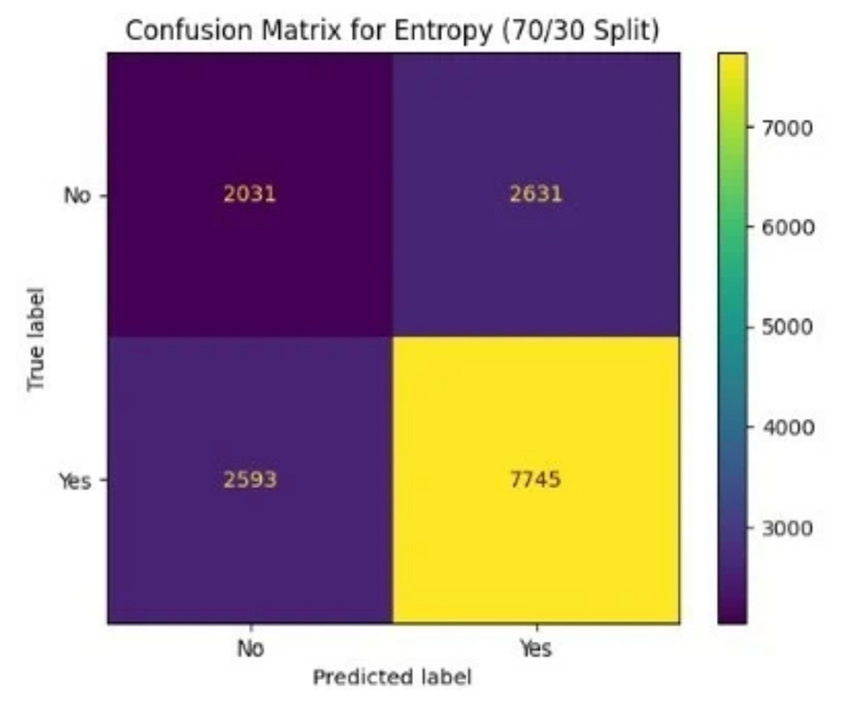
CONFUSION MATRIX
True Positive (TP): 9609
False Negative (FN): 729
True Positive (TP): 7745
False Negative (FN): 2593

Slide 12
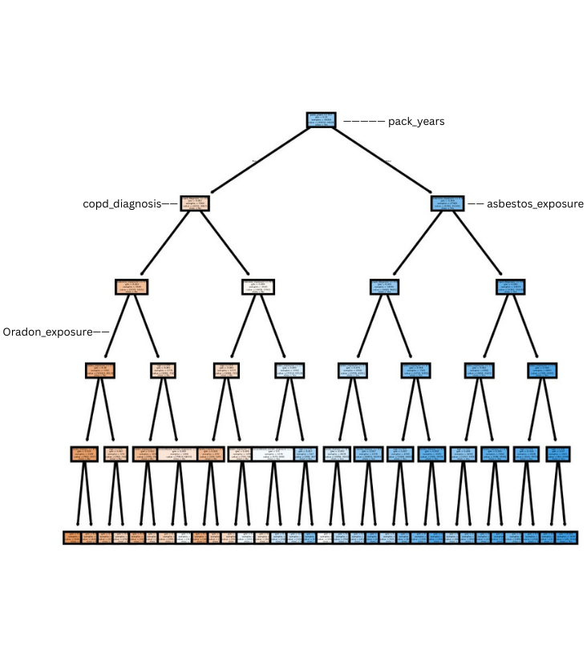
DECIDECISION TREE
Final Decision Tree based on the best-performing model (Gini, 70/30 split).
This split produced the highest accuracy, and the tree shows the most important features influencing lung cancer prediction.

Slide 13
CLUESTRING
Clustering is an unsupervised learning technique that groups patients based on similarity in their risk-factor attributes.
the model groups patients who share similar characteristics such as smoking level, radon exposure, asbestos exposure, and other medical risk factors.
After forming these clusters, the grouping structure can help identify patterns among patients and support future analysis or prediction for new patients with similar risk profiles.

Slide 14
CLUESTRING
TECHNIQUES
2-Standardization
1-Feature Selection
Remove non-useful columns
Scale all features to same range
3- K-Means Clustering
4- PCA Visualization
Reduce dimensions for 3D visualization
Group patients based on similarity

Slide 15
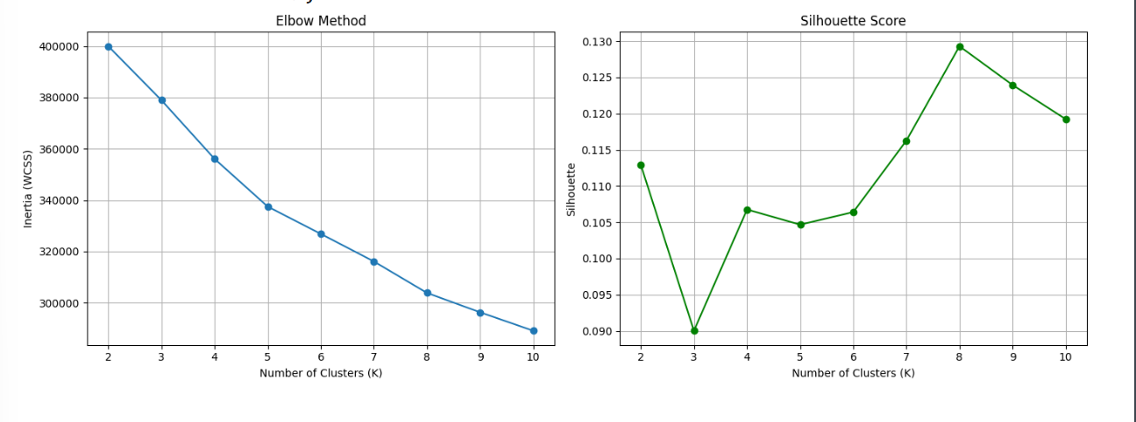
CLUESTRING
Elbow & Silhouette Evaluation
Elbow Method
No sharp “elbow” point
K = 4 and K = 6 show reasonable stability
K = 8 achieves the lowest WCSS → strongest compactness
Silhouette Score
K = 8 gives the highest silhouette value
Indicates the best separation between clusters
Confirms K = 8 as the optimal choice
Conclusion: Both metrics support choosing K = 8.

Slide 16
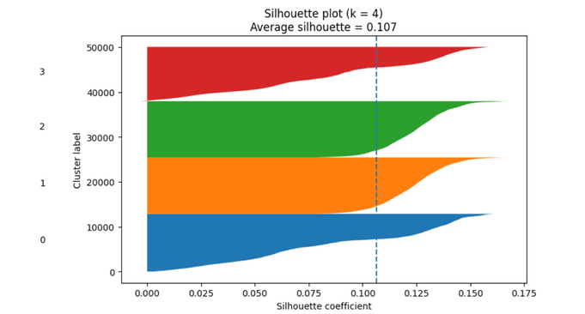
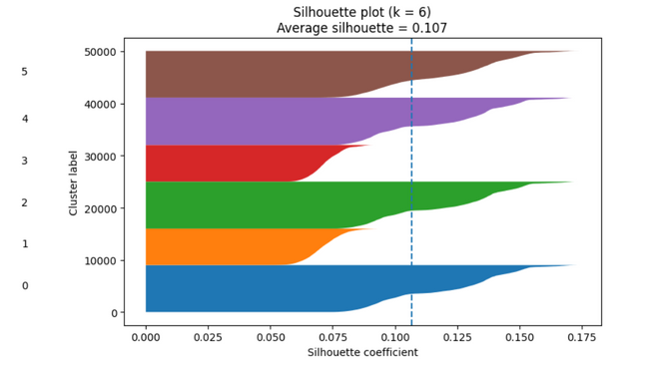
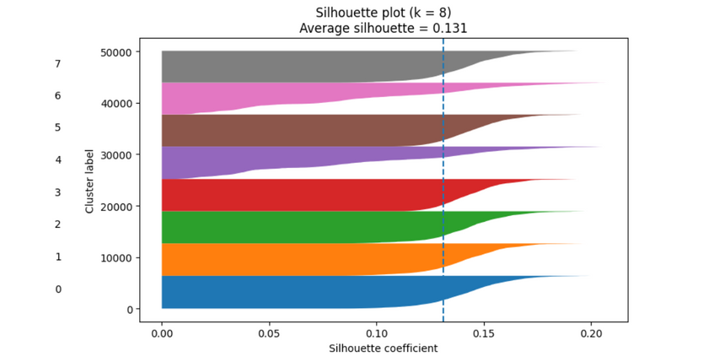
CLUESTRING
Silhouette Plots for Each K
silhouette analysis helps evaluate how well-separated and compact the clusters are.
Below are the silhouette plots for K = 4, K = 6, and K = 8.
- K = 4:Average silhouette ≈ 0.106
- K = 6:Average silhouette ≈ 0.107
- K = 8: Average silhouette ≈ 0.131 (highest, best separation)

Slide 17
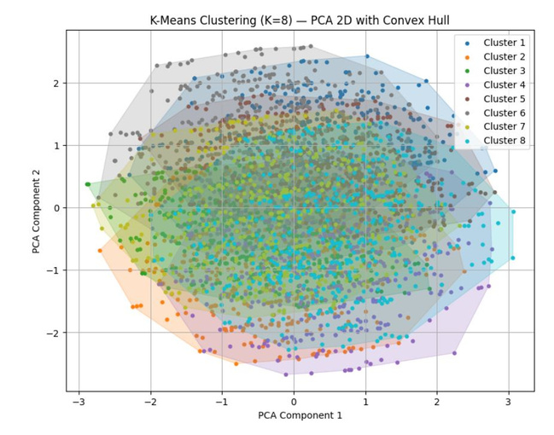
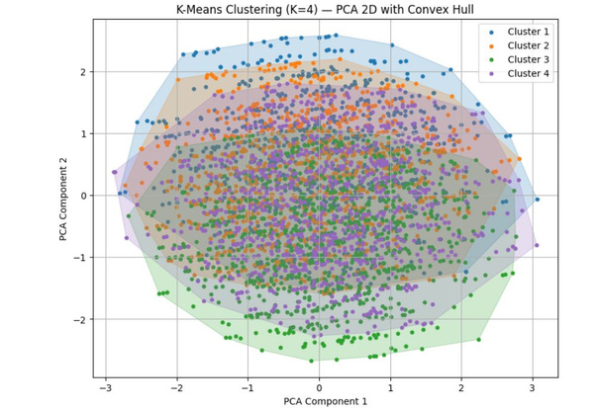
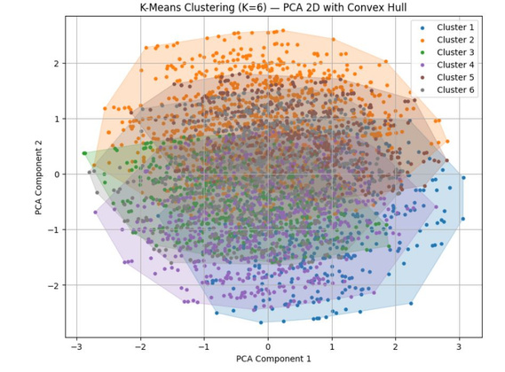
CLUESTRING
PCA CLUSTER VISUALIZATION
PCA (3D) WAS USED TO VISUALLY COMPARE CLUSTERS FOR K = 4, 6, AND 8.
K = 4
VERY BROAD CLUSTERS
SIGNIFICANT OVERLAP
WEAK SEPARATION
K = 6
Slightly moRE DEFINED STRUCTURE
OVERLAP STILL PRESENT
MODERATE IMPROVEMENT
K = 8 (Most cleAR)
MOST DEFINED CLUSTER BOUNDARIES
BETTER GROUPING AND LOWER OVERLAP
CONVEX HULL VISUALIZATION SHOWS CLEARER SEGMENTATION
FINAL : K = 8 provides the mOST STRUCTURED, COMPACT, AND INTERPRETABLE CLUSTERING.

Slide 18
FINDINGS
The 70/30 split gave the highest accuracy across all models.
Gini outperformed Entropy, achieving the best accuracy (0.729).
Both models struggled more with predicting the “Yes” class, likely due to feature overlap.
For clustering, K-means with K=8 produced the best separation
(highest silhouette score), PCA visualizations confirmed.
Overall, results show that multiple factors—not a single feature—drive lung cancer risk.
Most influential features: COPD diagnosis and smoking-related exposures.

Slide 19
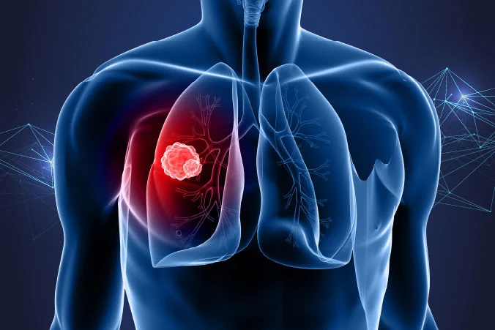
IT-326
THANK YOU

